Slide 1
UI Basics 4
Guangjian Zhou

Slide 2
What are RxJs in Angular ?
Reactive programming is an asynchronous programming paradigm concerned with data streams and the propagation of change (Wikipedia). RxJS (Reactive Extensions for JavaScript) is a library for reactive programming using observables that makes it easier to compose asynchronous or callback-based code. See (RxJS Docs).
RxJS provides an implementation of the Observable type, which is needed until the type becomes part of the language and until browsers support it. The library also provides utility functions for creating and working with observables. These utility functions can be used for:
Converting existing code for async operations into observables
Iterating through the values in a stream
Mapping values to different types
Filtering streams
Composing multiple streams

Slide 3

Explain string interpolation and property binding in Angular.
Interpolation refers to embedding expressions into marked up text. By default, interpolation uses the double curly braces {{ and }} as delimiters.
Property binding in Angular helps you set values for properties of HTML elements or directives. Use property binding to do things such as toggle button features, set paths programmatically, and share values between components.
To bind to an element's property, enclose it in square brackets, [], which identifies the property as a target property.
A target property is the DOM property to which you want to assign a value.
To assign a value to a target property for the image element's src property, type the following code:

Slide 4
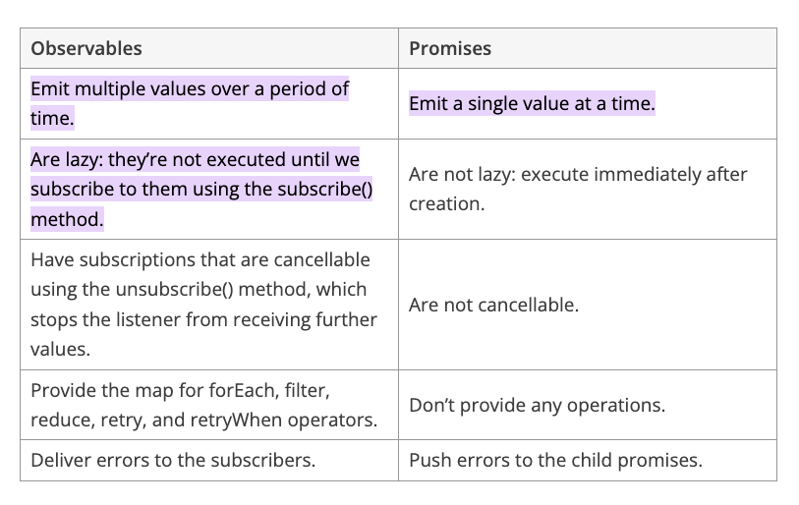
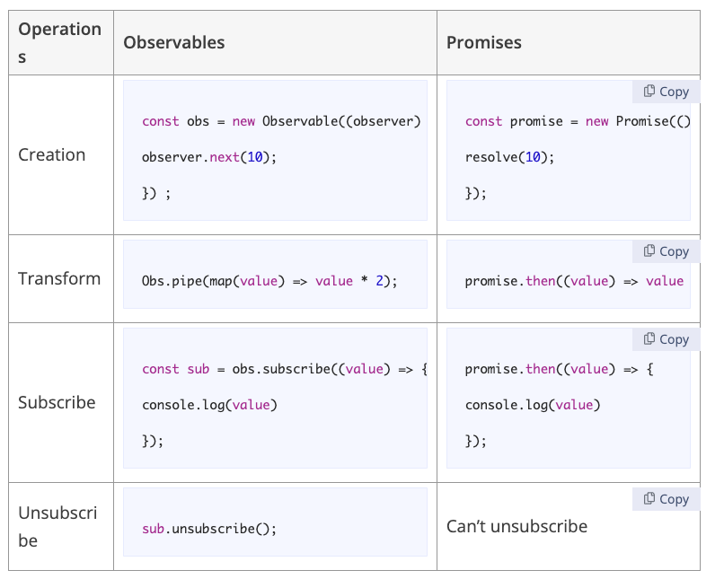
How are observables different from promises?

Slide 5
Explain the concept of Dependency Injection?
“In software engineering, dependency injection is a technique whereby one object supplies the dependencies of another object. A ‘dependency’ is an object that can be used, for example as a service. Instead of a client specifying which service it will use, something tells the client what service to use. The ‘injection’ refers to the passing of a dependency (a service) into the object (a client) that would use it. The service is made part of the client's state. Passing the service to the client, rather than allowing a client to build or find the service, is the fundamental requirement of the pattern.”

Slide 6
What are pipes in Angular explain with an example?
Use pipes to transform strings, currency amounts, dates, and other data for display. Pipes are simple functions to use in template expressions to accept an input value and return a transformed value. Pipes are useful because you can use them throughout your application, while only declaring each pipe once. For example, you would use a pipe to show a date as April 15, 1988 rather than the raw string format.
<p>The hero's birthday is {{ birthday | date }}</p>
<p>The hero's birthday is {{ birthday | date:"MM/dd/yy" }} </p>
The chained hero's birthday is {{ birthday | date | uppercase}}

Slide 7
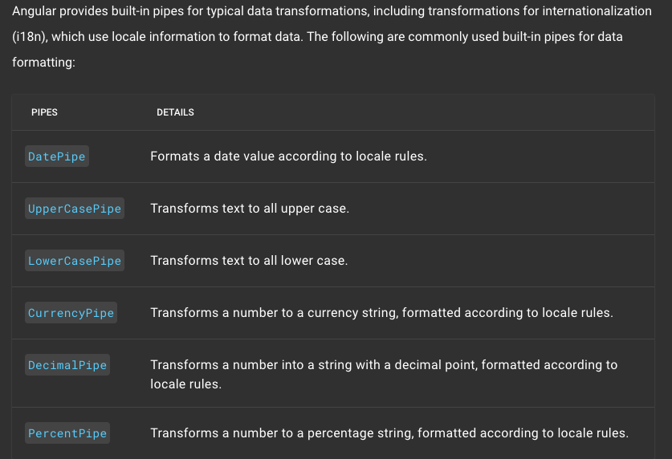
What are pipes in Angular explain with an example?

Slide 8
What exactly is a parameterized pipe?
In Angular, we can pass any number of parameters to the pipe using a colon (:) and when we do so, it is called Angular Parameterized Pipes.
<p>Date Pipe : {{today | date}}</p>
<p>Full Date : {{today | date:'fullDate'}}</p>
<p>Mediate Date : {{today | date:'medium'}}</p>
<p>Short Date : {{today | date:'short'}}</p>
<p>Date (dd/MM/yyyy) : {{today | date:'dd/MM/yyyy'}}</p>
<p>Time : {{today | date:'h:mm a z'}}</p>
<p>Medium Time : {{today | date:'mediumTime'}}</p>

Slide 9
What are class decorators?
Angular offers us a few class decorators. These are the top-level decorators that we use to express intent for classes. They allow us to tell Angular that a particular class is a component, or module, for example. And the decorator allows us to define this intent without having to actually put any code inside the class.
@NgModule. @Component. @Injectable. @Directive. @Pipe
@Component and @NgModule are widely used.

Slide 10
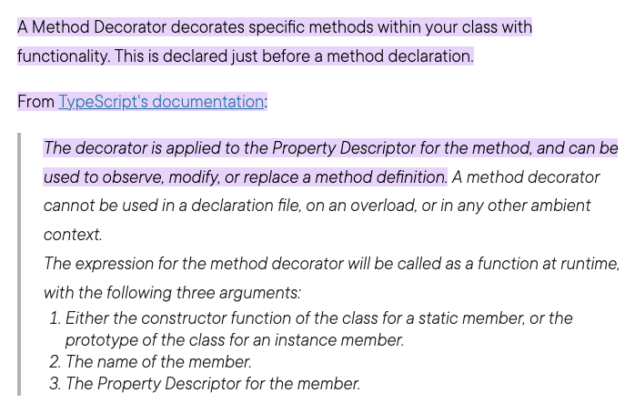
What are Method decorators?

Slide 11
What are property decorators?
Property Decorators are applied to the properties of the class.
@Input @Output @ContentChild & @ContentChildren @ViewChild & @ViewChildren @HostBinding

Slide 12
What is the Component Decorator in Angular?

Slide 13
What are lifecycle hooks in Angular? Explain a few lifecycle hooks.

Slide 14
What are router links?

Slide 15
What exactly is the router state?

Slide 16
What does Angular Material means?

Slide 17
What is ngOnInit?

Slide 18
What is transpiling in Angular ?

